Slide 1

FAIR HOUSING ESSENTIALS
AUGUST 26, 2020

Slide 2
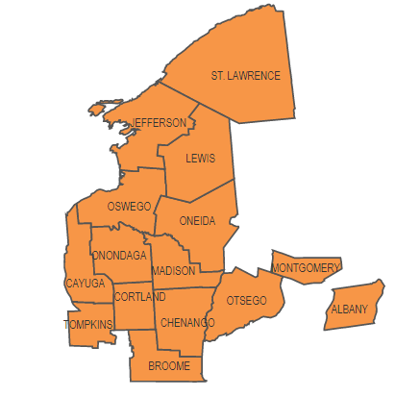
About CNY Fair Housing
Private, non-profit organization founded in 1991
Investigate housing discrimination and provide legal representation to victims of discrimination

Slide 3

Protected Classes Under Fair Housing Laws
Federal Law:
Race
Color
National Origin
Religion
Sex/Gender
Disability
Familial Status
State Law:
Age
Marital Status
Military Status
Sexual Orientation
Gender Identity
Source of Income

Slide 4
Who (and what) is covered by fair housing laws?
Fair Housing laws apply to:
  Landlords
  Housing staff
  Leasing agents
  Management companies
  Real estate brokers
  Owners
  Homeowner’s insurers
  Mortgage lenders
What housing is covered?
  In New York State, any housing except owner-occupied buildings with two or less units are covered by fair housing laws
  Race and color protections apply to every housing unit
  However, under certain circumstances, age-restricted senior housing is permitted

Slide 5
Prohibited Conduct
A landlord cannot, on the basis of a protected class:
  Refuse to rent or sell an apartment or house
  Lie about availability of housing
  Steer applicants into or away from certain areas of a building or to different buildings or neighborhoods to segregate populations

Slide 6
What conduct is illegal?
  Set less favorable terms and conditions
    Charge higher rents
    Insist on month-to-month instead of one-year lease
    Differences in application process or requirements
      Require more invasive background checks
    Applying property rules differently because of protected status

Slide 7
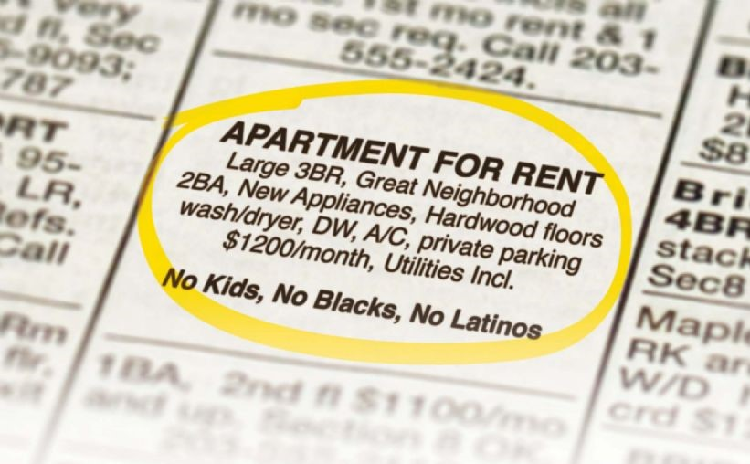
Discriminatory Advertising
It is illegal to post, or cause to be posted, any advertising or statement that indicates a preference, limitation, or discrimination
  This includes posted signs, newspapers, Craigslist, Facebook, and others

Slide 8




Source of Income
NEW LAW THAT TOOK EFFECT IN APRIL IN NEW YORK STATE
CANNOT BE DENIED HOUSING OR TREATED DIFFERENTLY BECAUSE YOU RECEIVE SECTION 8 OR PUBLIC ASSISTANCE
LANDLORDS CAN NOT ADVERTISE “NO SECTION 8” OR “NO PA” OR “NO PROGRAMS”
LANDLORDS MUST BASE INCOME REQUIREMENTS ON THE TENANT’S SHARE OF THE RENT

Slide 9


Familial Status
Familial Status: families with children under the age of 18, pregnant women, anyone who has or is trying to obtain custody of minor children (adoption, foster care, grandparents)
Landlords can limit the number of people that live in an apartment, but it has to be based on the size of the apartment.
Very small bedrooms can be limited to one person
Large bedrooms may be able to have three people
Children under 2 do not count when determining the number of people per bedroom.

Slide 10
Harassment
Sexual Harassment
  Quid Pro Quo: requests for sex in exchange for housing or housing services
  Hostile Living Environment: conduct that is severe or pervasive
Harassment can be written, verbal, or other conduct, and does not require physical contact
Protections include harassment based on race, national origin, sexual orientation, etc.
May include harassment by the housing provider, their staff, or by neighbors.

Slide 11

Criminal Background Screening
Blanket bans on individuals with criminal histories are considered discriminatory
Housing provider should conduct an individualized assessment that considers:
  Nature and severity of offence
  Time since conviction
  Behavior in intervening time
Provider should be prepared to show their policy serves a “substantial, legitimate, nondiscriminatory interest”

Slide 12
Domestic Violence
Domestic violence survivors are protected under fair housing laws and other state laws
Housing providers can not evict domestic violence victims because of incidents or police activity at the property
Local governments can not require that landlords evict domestic violence victims because of police activity
Domestic violence survivors living in subsidized properties have rights under VAWA
  Emergency transfers
  Self-certification by survivors
  Can’t deny housing due to adverse effects of abuse

Slide 13
Disability Discrimination
Housing providers:
  Cannot refuse to rent or sell to prospective residents based upon their disability;
  Should not ask questions about the nature or extent of a person’s disability;
  Are obligated to provide equal access and opportunity for persons with disabilities to use and enjoy the housing.

Slide 14
Reasonable Accommodations
Accommodation: a change, exception, or adjustment in normal rules, policies, practices, or services offered by a housing provider to allow persons with disabilities the full use and enjoyment of their dwelling and related facilities.

Slide 15
Reasonable Accommodations - Examples
Assistance animals
Assigned parking spaces
Transferring Units
Communication methods
Trash Pickup
Snow Removal
Leniency for behavior that violates a lease

Slide 16
Reasonable Modifications
Modification: a structural modification that is made to allow persons with disabilities the full use and enjoyment of their dwelling and related facilities.

Slide 17
Reasonable Modifications - Examples
Ramps
Grab bars
Sidewalks
Flashing smoke alarms or door bells

Slide 18
Reasonable Modifications
Federally subsidized housing (public housing & other HUD subsidized housing) - housing provider is responsible for costs of all modifications.
Private housing - tenant is responsible for paying for modifications within their units while the landlord is responsible for paying for some modifications to common areas.

Slide 19
Disability Under Fair Housing Laws
“Any person who has a physical or mental impairment that substantially limits one or more major life activities; has a record of such impairment; or is regarded as having such an impairment.”
Examples include mobility impairments, visual or hearing impairments, major diseases, mental illness, depression, anxiety, PTSD, & autism.

Slide 20

What is Reasonable?
Changes that do not impose an undue financial and administrative burden or that would fundamentally alter the provider’s operations
Takes into account:
  the financial resources of the provider
  the costs of the accommodation or modification
  the benefits to the requester
  the availability or other, less expensive alternative options

Slide 21
What is required for a reasonable accommodation or modification?
Request does not need to be made in a particular way
  Tenant just needs to make their needs known to housing provider
  Recommend that requests be made in writing and ask that the housing provider responds in writing
  A housing provider may have a particular form or process for requesting an accommodation or modification but they can not require that the tenant use that form or process.

Slide 22
What is required for a reasonable accommodation or modification?
If the disability is not obvious, person should be prepared to provide information from a third party that:
  verifies that they meet the Act’s definition of disability
  describes the needed accommodation or modification
  shows the relationship between the person’s disability and the need for the requested accommodation and modification

Slide 23
What is required for a reasonable accommodation or modification?
Housing provider cannot place excessive restrictions as a condition of granting the accommodation or modification
Housing provider cannot charge additional fees as a condition of granting the accommodation or modification
  Includes pet fees and pet deposits for assistance animals, parking fees, or transfer fees if an individual needs to switch units for a disability related need
  Cannot be called an “administrative fee”
Excessive delays in granting accommodations or modifications may also be violations

Slide 24





Tips in Protecting Rights
Sign a lease
Make all requests in writing and ask for all responses in writing and keep copies of all paperwork
Get receipts for all rent payments
Keep a log of your housing search including what housing providers you’ve contacted and what happened
Take photos of the apartment before you move in and right after you move out
If you are being harassed by the landlord or a neighbor, you can record your interactions

Slide 25
Fair Housing
Questions/Inquiries?
CNY Fair Housing, Inc.
731 James Street, Suite 200
Syracuse, NY 13203
Phone: (315) 471-0420
Website: www.cnyfairhousing.org

